Slide 2
Versions

Slide 3
Versions
Accpac.Advantage and Accpac.Advantage.Types now 6.7.0.0
Application now 67A
Visual Studio 2019 now supported for Web development
.Net Framework is still 4.7.2
We are still using Visual Studio 2017 for desktop component compilations

Slide 4
Wizards

Slide 5
Wizards
Updated for 2020.0 release of the Sage 300 Web SDK
Solution Generation Wizard
Code Generation Wizard
Upgrade Wizard
Customization Wizards (Plugin and Standalone)
Incorporation of Sage branding
Adoption of consistent, unified color scheme
Incorporation of Sage logo
Cleaner, less-cluttered design
More readable text with increased use of white space
3rd party library ‘Metro Modern UI’, MIT license
All Wizards are compatible with Visual Studio 2017, 2019

Slide 6
Solution Wizard

Slide 7

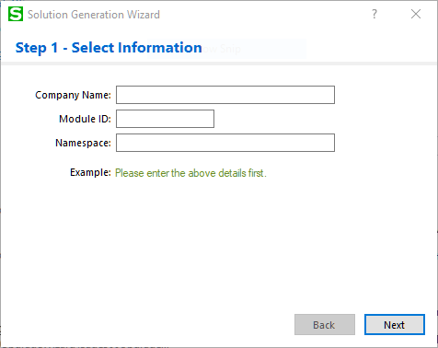
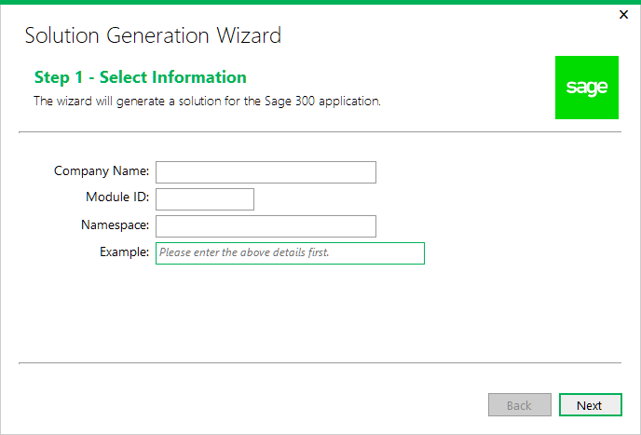
Solution Wizard
2019.2
2020.0

Slide 8

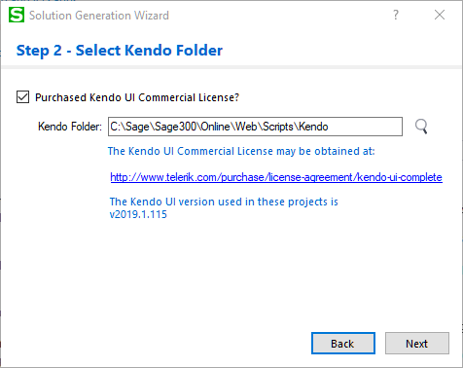
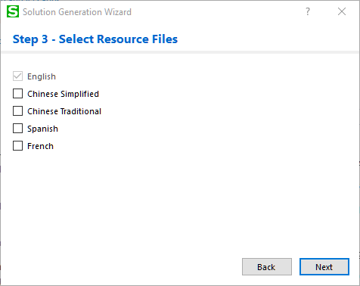
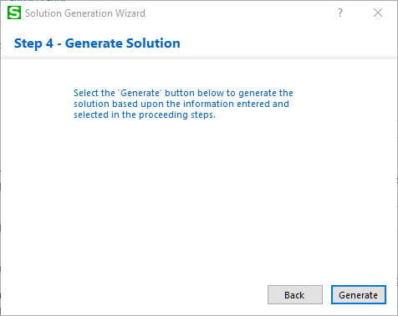
Solution Wizard

Slide 9

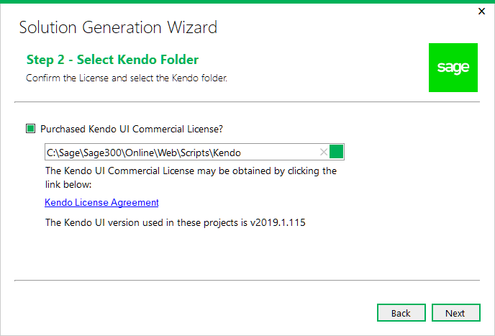
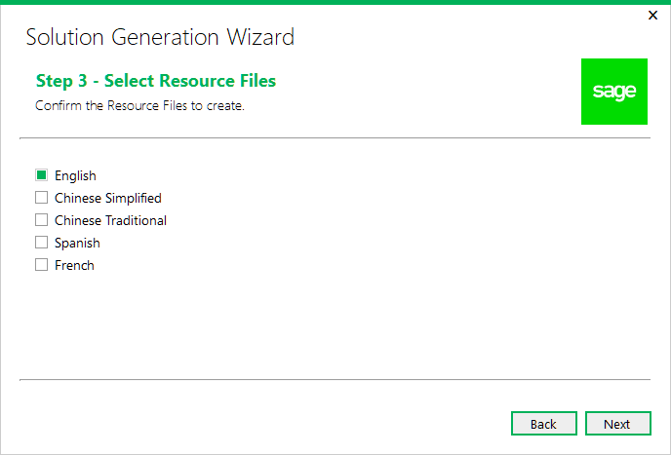
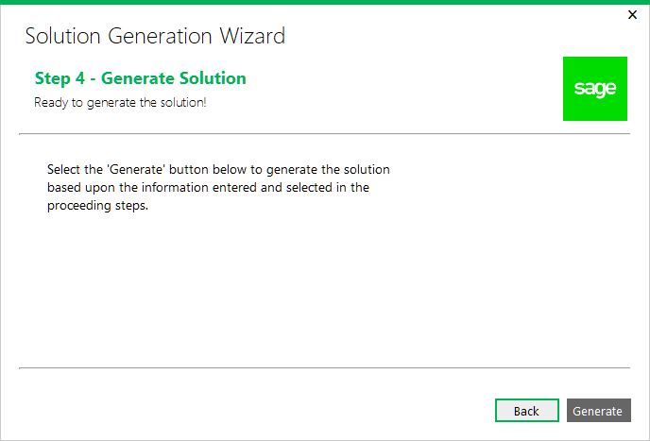
Solution Wizard

Slide 10
Code Generation Wizard

Slide 11
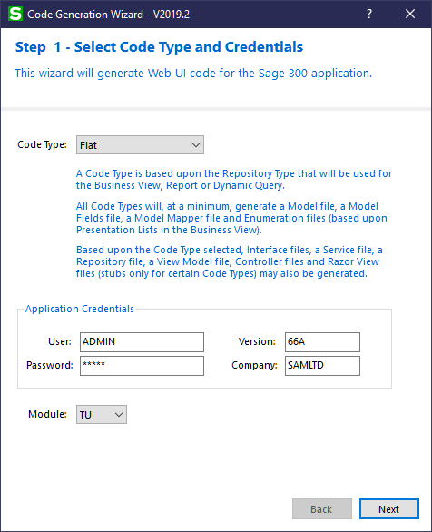
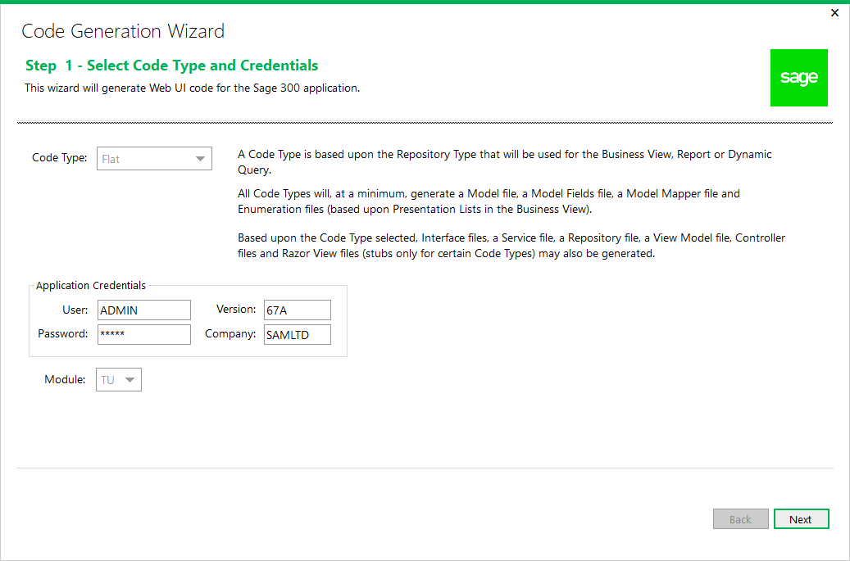
Code Generation Wizard
2019.2
2020.0

Slide 12
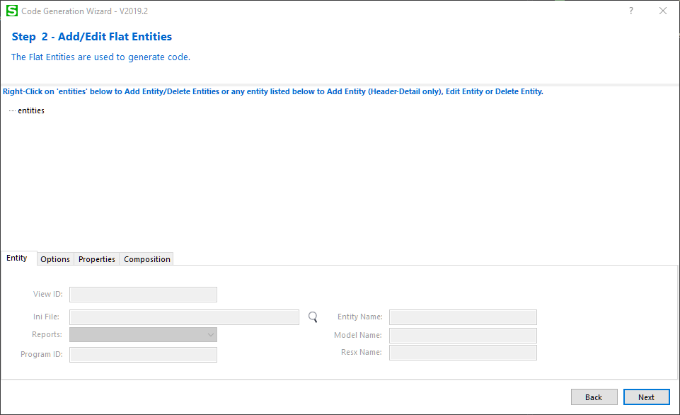
Code Generation Wizard

Slide 13
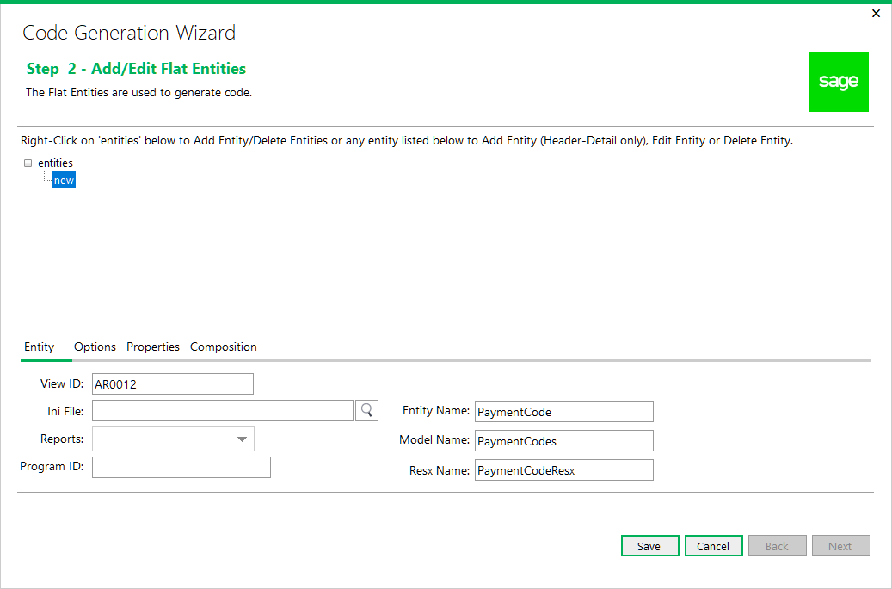
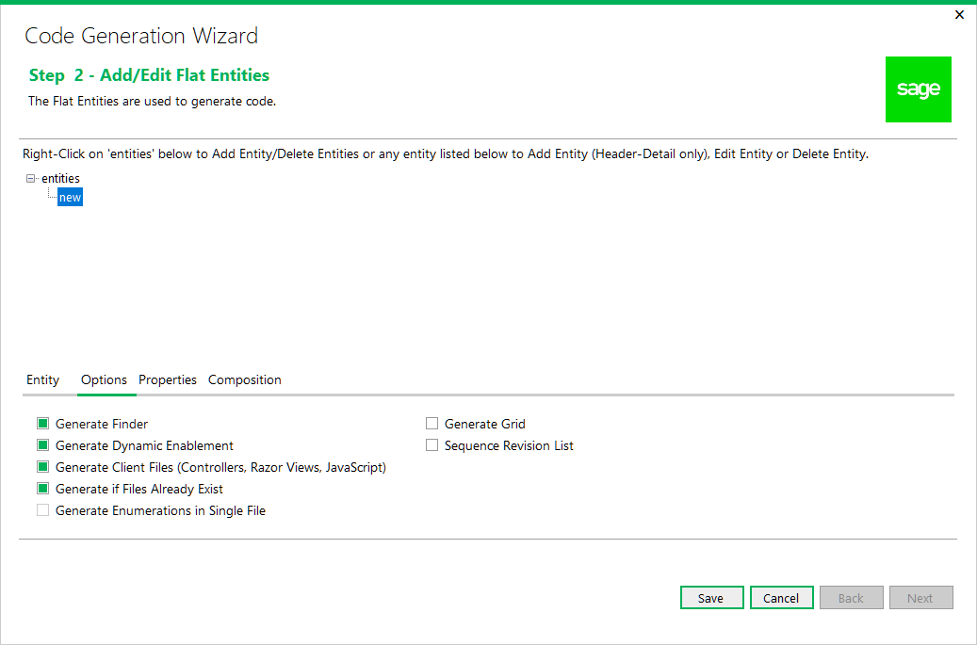
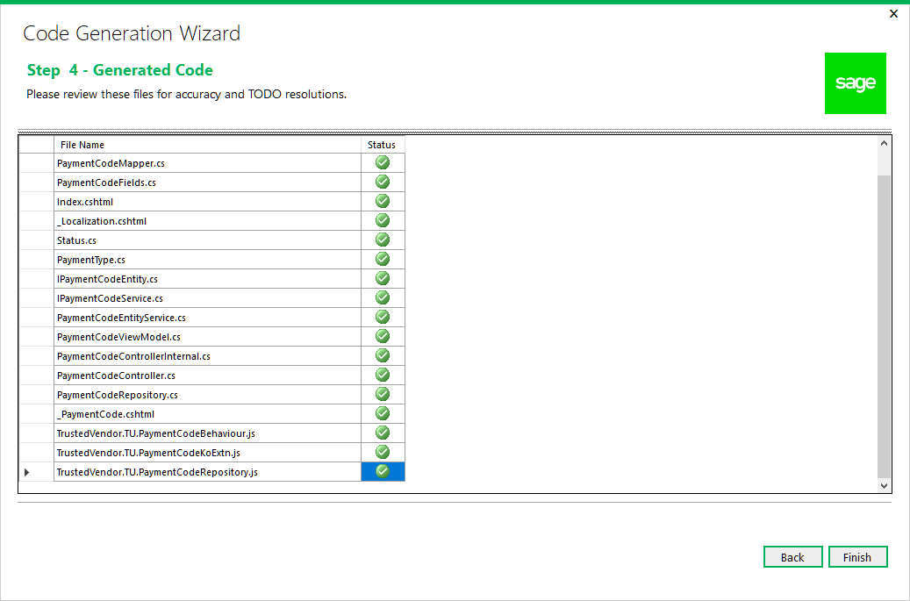
Code Generation Wizard

Slide 14
Code Generation Wizard
Added check with message if Accpac Libraries not compatible with wizard
Multiple Session Changes
XXAreaRegistration.cs, Global.asax.cs, Web.Config, PageUrl.txt, ..Behaviour.js files, Session segment

Slide 15
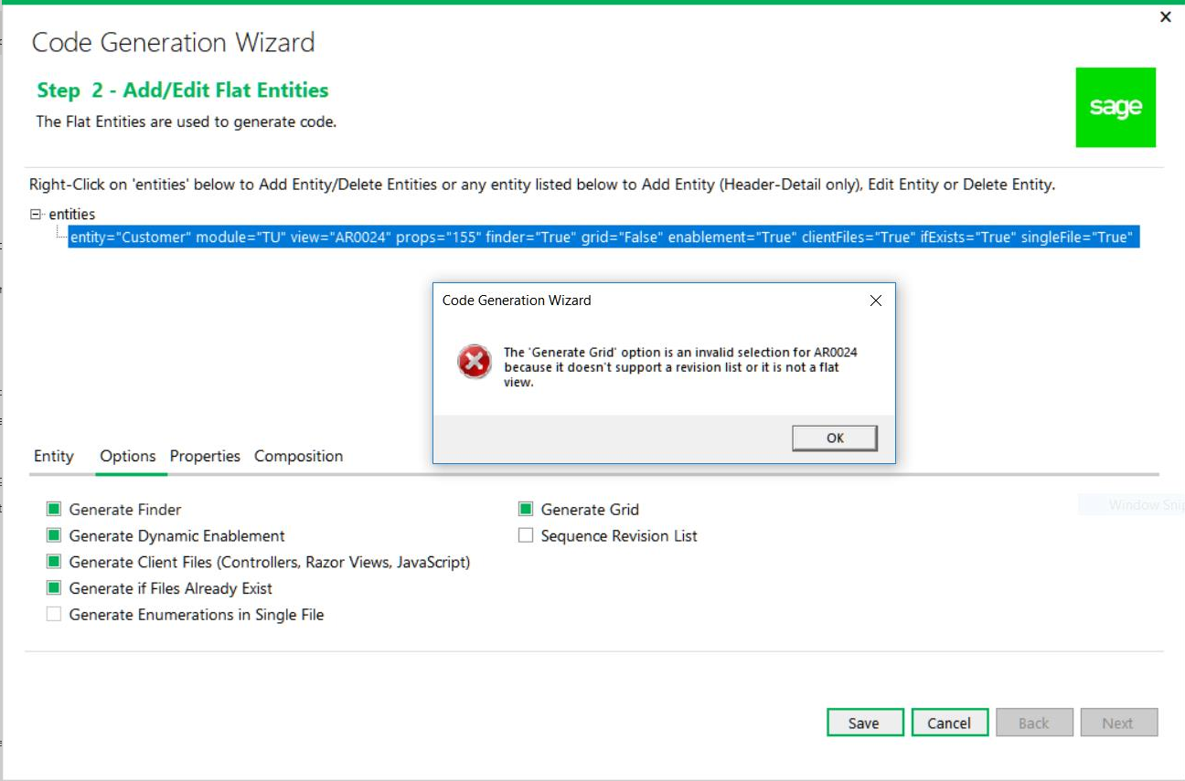
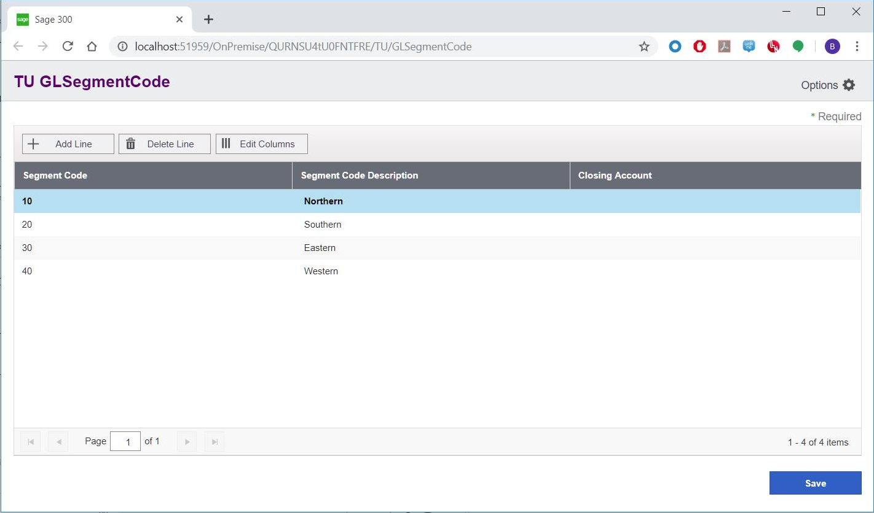
Code Generation Wizard
Added ability to generate a grid for the Flat Code Type
Accpac View must be Flat View and Revision List
#define FLAT_VIEW 1, #define HAS_REVISIONS 2

Slide 16
Upgrade Wizard

Slide 17
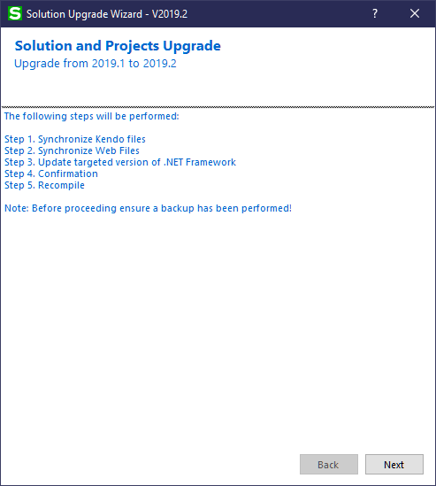
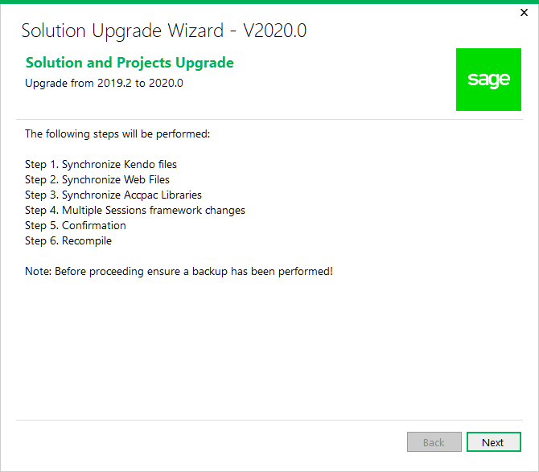
Upgrade Wizard
2019.2
2020.0

Slide 18
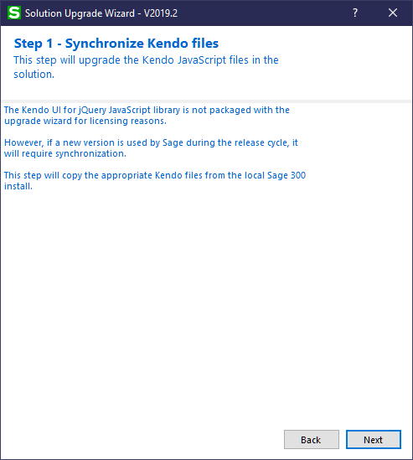
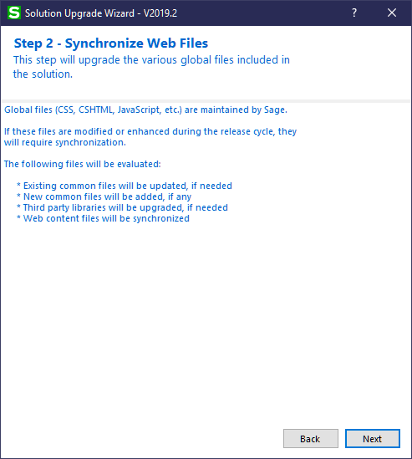
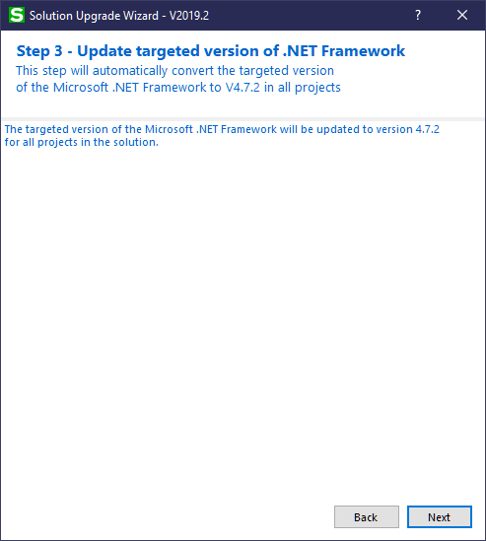
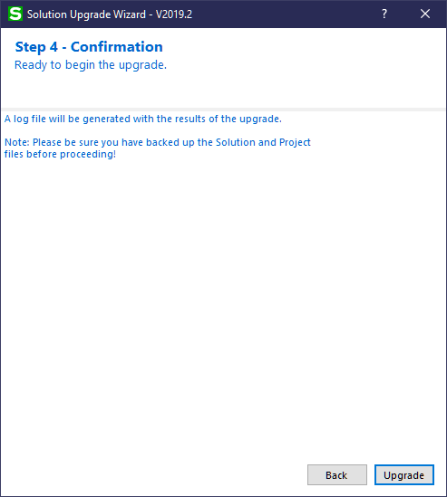
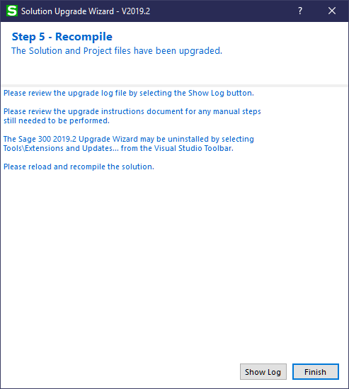
Upgrade Wizard

Slide 19
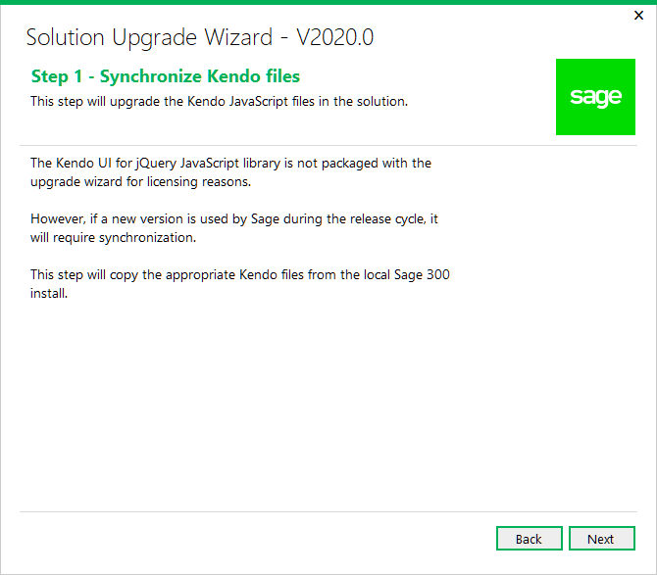
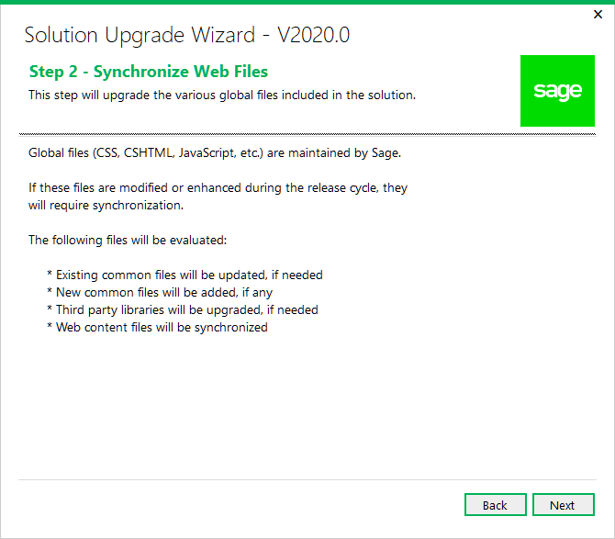
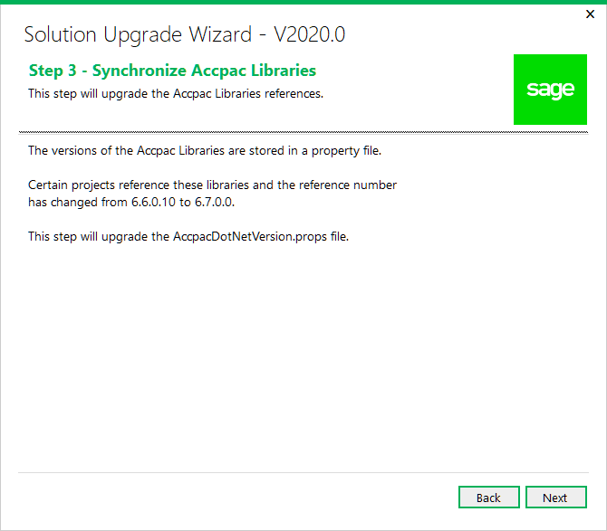
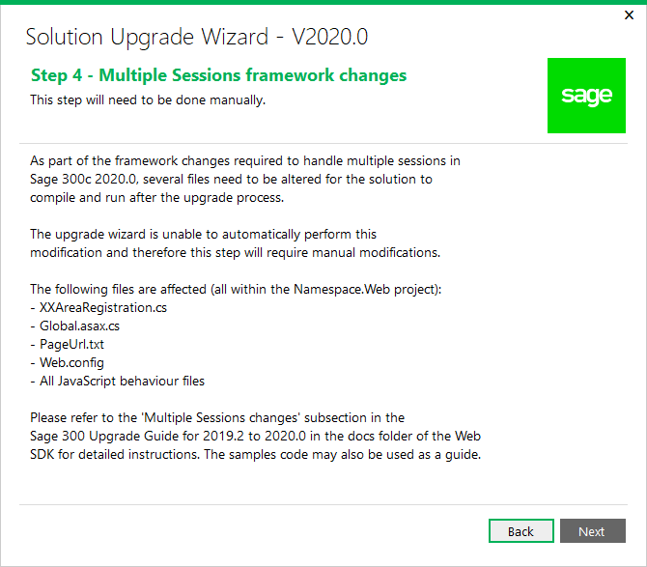
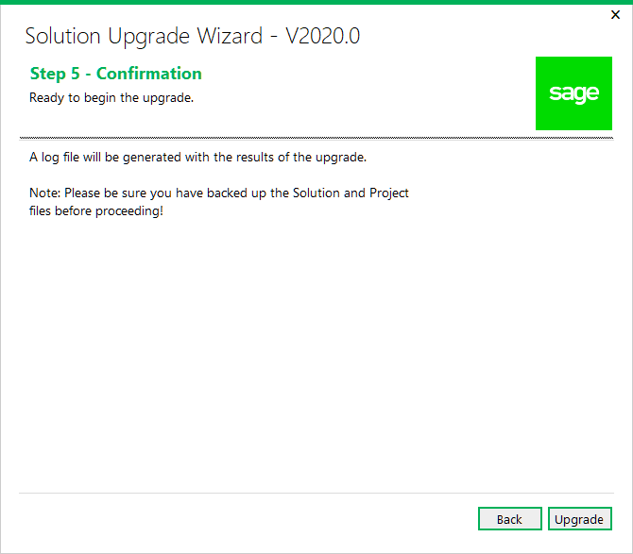
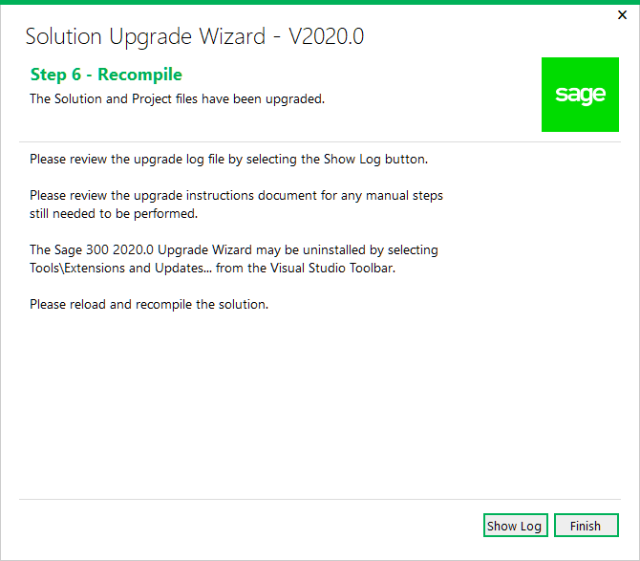
Upgrade Wizard

Slide 20
Samples

Slide 21
Samples
Segment Codes modified to use new grid
Multiple Session Changes
XXAreaRegistration.cs, Global.asax.cs, PageUrl.txt, Web.Config, ..Behaviour.js

Slide 22
Utilities

Slide 23
Utilities
MergeISVProject
Corrected defect where minification of JavaScript fails if file path has a space
2020.1
Copy all external files required for asp_compile.exe

Slide 24
Documentation

Slide 25
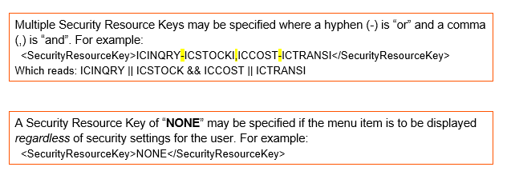
Documentation
Updated upgrade instructions for 2019.2 to 2020.0 in docs/upgrades
New Sage300SDK_2020WebSDKOverview.pptx in docs/presentations
Updated docs for copyrights, screenshots, etc.
Updated Sage300SDK_DevelopingNewApplication in docs/development

Slide 26
Partner Enhancements in Application

Slide 27
Partner Enhancements in the Application
Unhandled errors in web screens are now logged in trace.log
New Grid issues and enhancements addressed based upon 2019.2 release
Mask issues addressed in the new Finder
Exception logging in the Business Entity Session to now contain the Error Stack
New property in Context for session
Removed IE11 as a supported browser for Sage 300 Web Screens
“NONE” security resource key in menu XML to result in menu item always showing
Instrumentation Page (Core/Instrumentation) for resources used in the web screens

Slide 28
Desktop SDK CHM Files

Slide 29
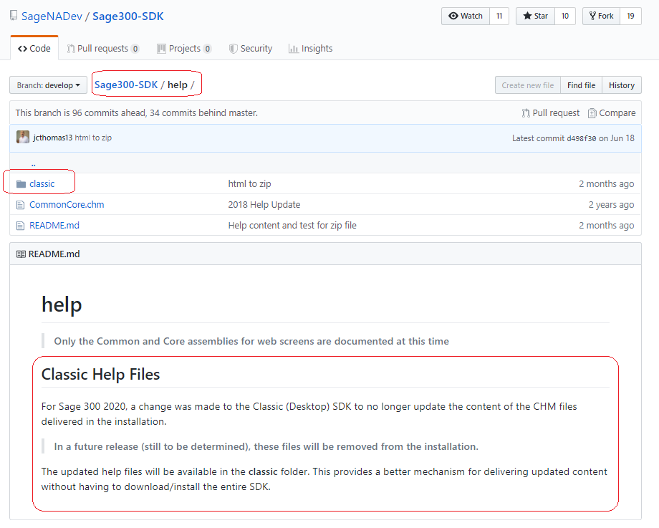
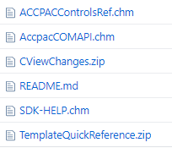
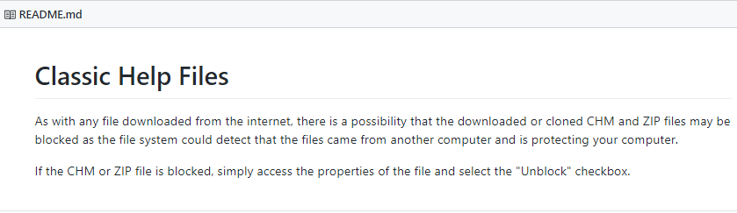
Desktop SDK CHM Files
Sage 300 is eliminating the delivery of CHM files starting with release 2020
Classic SDK CHM and HTML Help files now available in Open Source GitHub Repository

Slide 30
Web API Sample POST Payloads

Slide 31
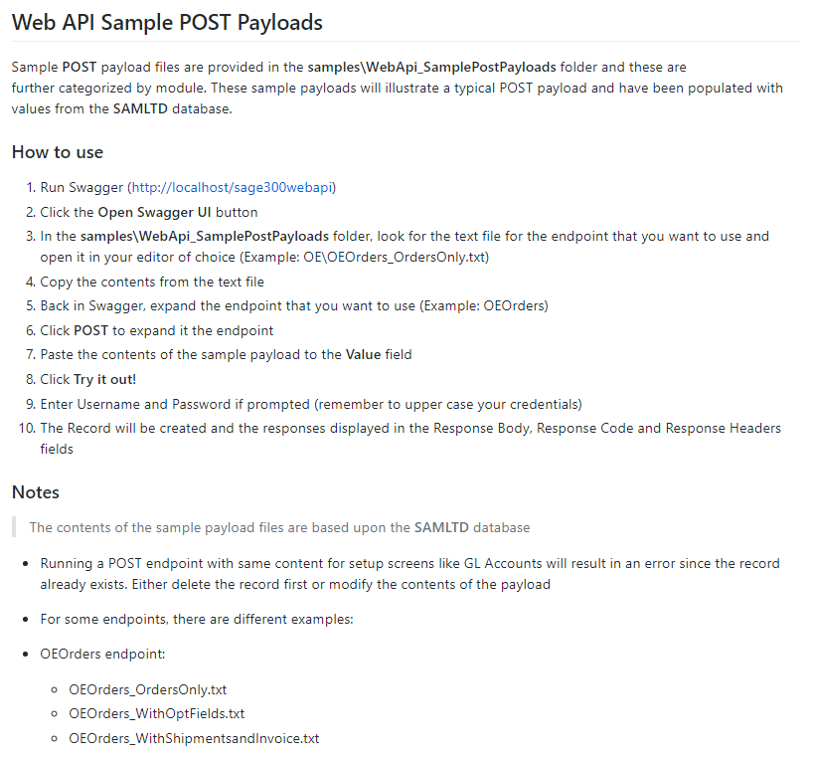
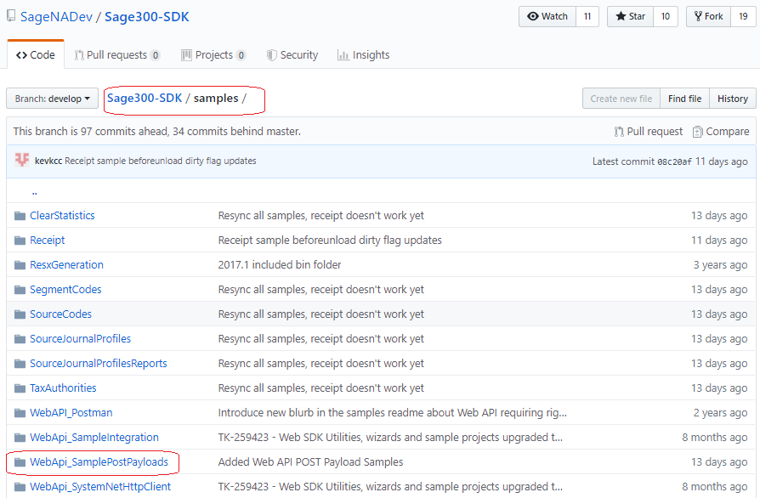
Web API Sample POST Payloads
Sample POST Payloads are now included the samples/WebApi_SamplePostPayloads folder
Payload samples are in module specific folders

Slide 32
Web Screen Proxy

Slide 33
Web Screen Proxy
2019.1 released the WebScreenProxy for use by the CRM Integration
2019.2 saw issues in the proxy dealing with
ASP.NET Session ID instability
JavaScript Unload event not being called
Elevated Accpac Session counts
2020 has eliminated this WebScreenProxy as a separate component
Moved into the Sage 300 application
CRM integration component simplified
Eliminated issues

Slide 34
Multiple Sessions

Slide 35
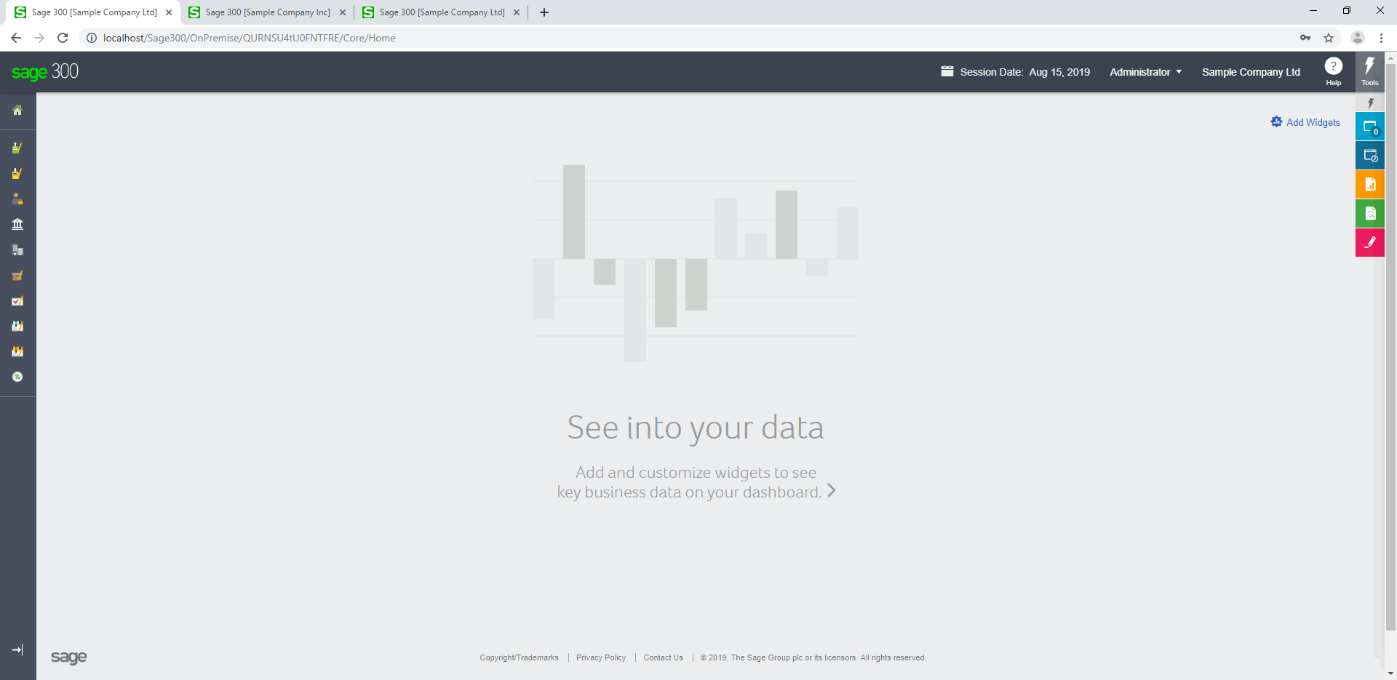
Multiple Sessions

Slide 36
Previous Session Implementation
Login as Fred
IIS Session Cache “authinfo”
Web Screen
Screens are disconnected from Context
Must ask, “Who am I?”
Session stores 1 and 1 only context
When we ask who am I, there is only one answer
Cannot have multiple users with this architecture
Multiple tab pages not possible
Uses the IIS SessionID as the Context.SessionId
Unique in IIS Session, but not between tab pages

Slide 37

New Session Implementation
Tab 1 - CRM
Tab 2 - 300
Tab 3 – 300
Tab 4 - 300
Sage 300 Screen
Sage 300
Sage 300
Sage 300
User 1
Comp 1
Id User1|Comp1
User 1
Comp 1
Id User1|Comp1
License checks
IIS Session ID XYZ
User 1
Comp 1
Id User1|Comp1
License checks
IIS Session ID XYZ
User 2
Comp 2
Id User2|Comp2
License checks
IIS Session ID XYZ
User 1
Comp 1
Id User1|Comp1
No license checks
IIS Session ID XYZ
Logout if new credentials
License Count is 2
No license from CRM access
Only two users in this browser instance
Handles multiple users and multiple companies
Id added to URL
Handles CRM scenarios
User 1
Comp 2
Id User1|Comp2

Slide 38
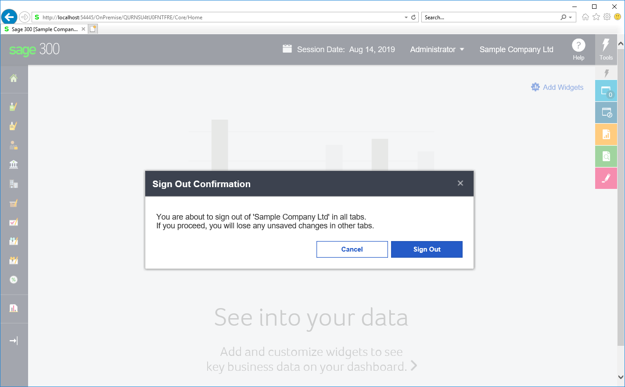
Logout Implementation
sg.utls.logout
Authentication Controller
Login Screen
Session Expired
New Tenant Screen
Admin Screen
Home Page

Slide 39
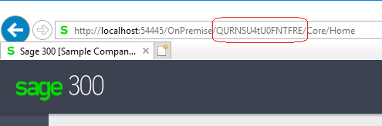
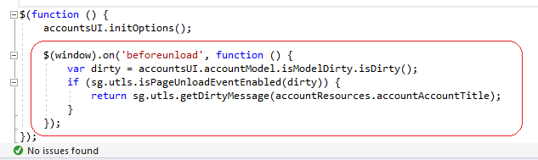
Multiple Sessions
New segment added to URL (Session Segment)
Browser is sandboxed from other browsers
Logout will logout other tab pages in sage browser with same credentials
Single warning from main tab page only
Dirty flags ignored in other tab pages
All ..Behaviour.js files affected with new PageUnloadManager

Slide 40
Multiple Sessions and Partner Icons
In 2019.2, Partner Icons are in the ../Online/Web/External folder
In 2020, a defect with the Multiple Session implementation has been discovered AFTER 2020 has been released where the application will look in the ../Online/Web/OnPremise/External folder
The addition of the new segment in the URL was not accounted for in this area of the code
For the 2020 release, a partner can place icons in both folders to solve this issue as a Hotfix will not be made
This will be corrected in 2020.1 to account for the additional segment

Slide 41
LanPak Licensing in the Web

Slide 42
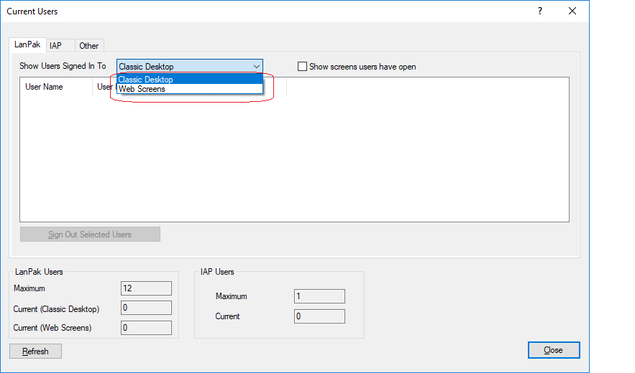
LanPak Licensing in the Web
What does not consume a LanPak license
Web API
Sage 300 Web Screens invoked by CRM integration
PJC Payroll Timecard screen
LanPak license sandboxed to browser instance (i.e. Chrome, Firefox, Edge)
License to be consumed by user and company combination per browser
Desktop Current User Screen shows Web Users

Slide 43
Patch

Slide 44
Patch
New Grid Framework Patch
An issue was recently discovered in the grid framework where overriding the Sage Grid Controller did not result in the custom controller being invoked
As a result, the developer could not override the CRUD operations for a grid on the server side
This patch will be part of the Sage 300 2020.1 code base
See the README file in the patch folder of the Web SDK for instructions on installing the patch
If grid development is not performed, this patch is not required to be applied

Slide 45
Coming in 2020.1 in the Web

Slide 46
Coming in 2020.1 in the Web
Web API
Better batch logic (all or nothing) (start with AR Invoices)
Invalid Error message when payload contains an invalid item number
New Companies List endpoint and CRM Bi-directional endpoints as needed
Web SDK
Open a view more than once in the Business Repository
Popups are not providing a good developer experience
New Finder needs an ID and direct (expanded) interface without “stacking” parameters
Binding ko.computed property to a label
disable/disabled logic not unified
RVSpy Performance enhancement
Application
PDX Improvements – Browser Icon, Menu Icons, Submenus, Signpost on Dashboard
Evict User – SignalR, free LanPaks from Web users
Multiple Contacts – Customer and Vendor (new MT module, backwards compatibility with innovation)
Better Logging – Breadcrumbs
Feature Assessment – SSRS (SQL Server Reporting Services)
CRM bi-directional integration

Slide 47
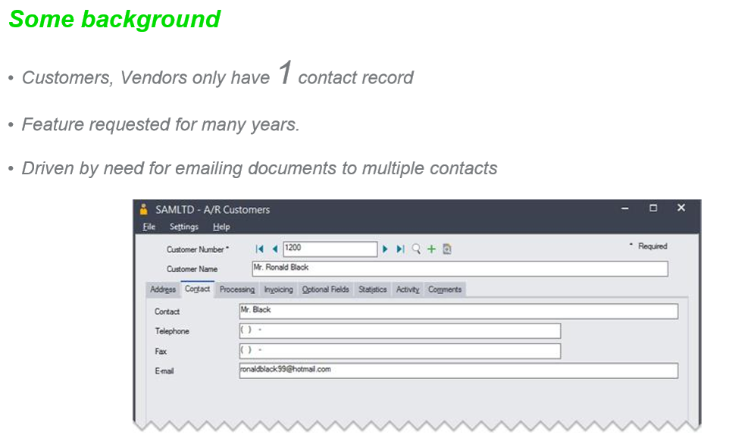
Multiple Contacts for Customers and Vendors

Slide 48
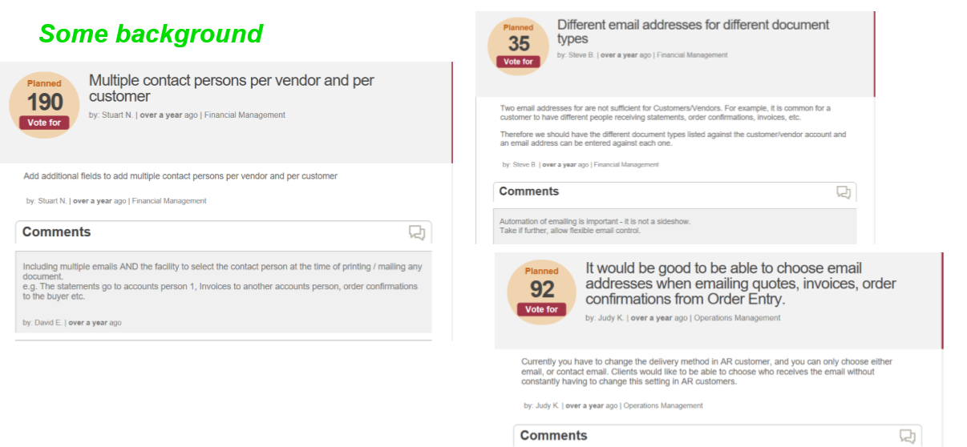
Multiple Contacts for Customers and Vendors

Slide 49
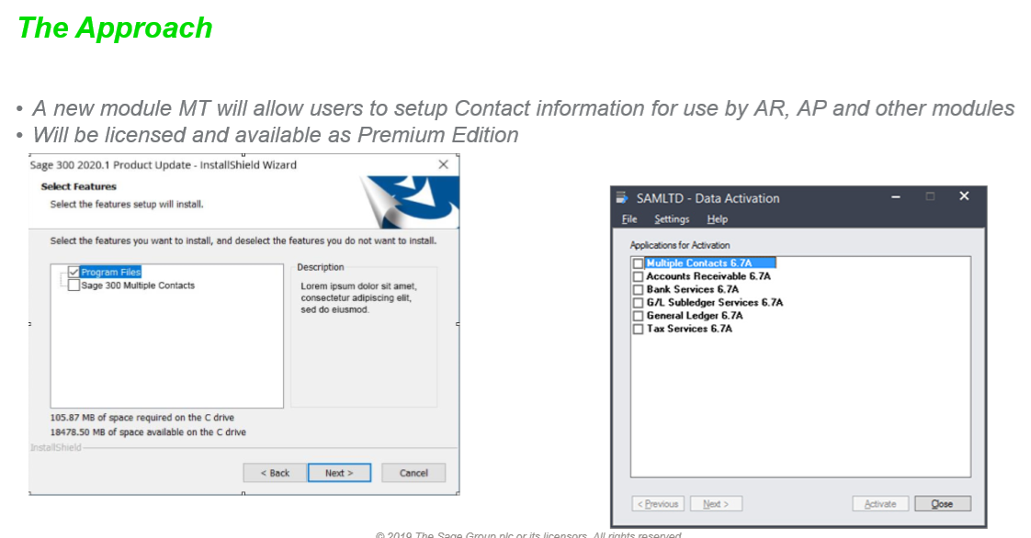
Multiple Contacts for Customers and Vendors

Slide 50
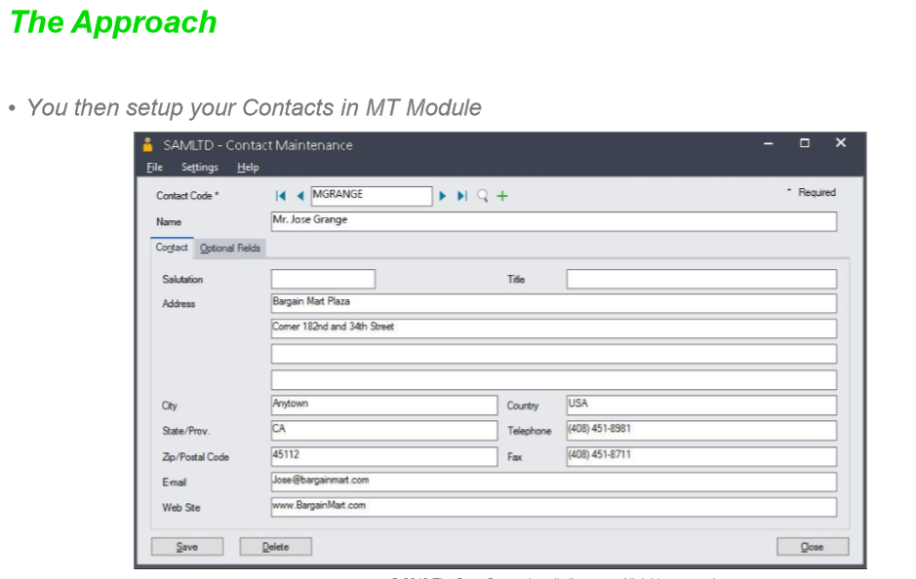
Multiple Contacts for Customers and Vendors

Slide 51
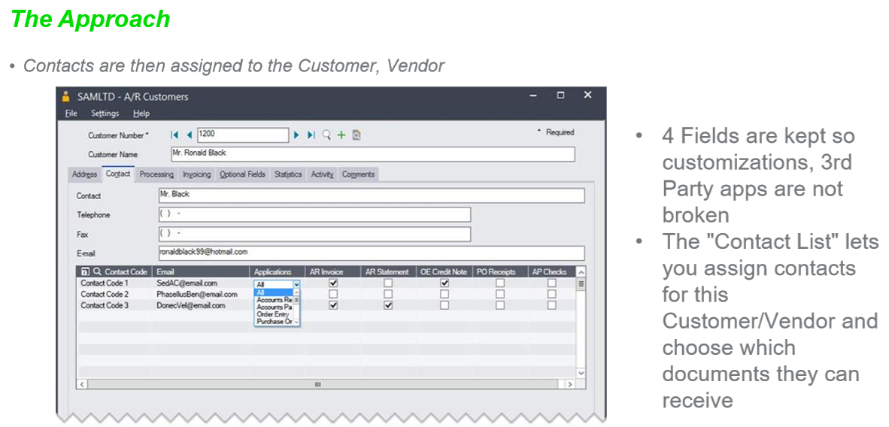
Multiple Contacts for Customers and Vendors

Slide 52
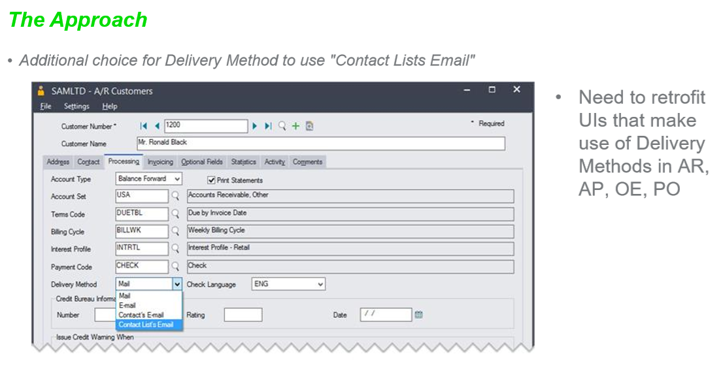
Multiple Contacts for Customers and Vendors

Slide 53
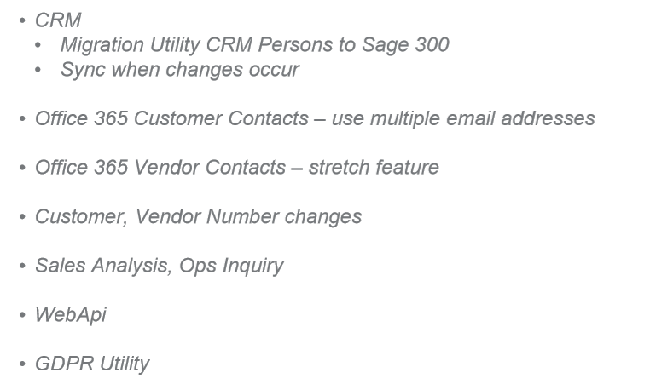
Multiple Contacts Integration

Slide 54
GitHub Repository
Open Source
https://github.com/SageNADev/Sage300-SDK
2020 is available in the “master” branch
2020.1 is available in the “develop” branch (in-progress)
Archives
2019.2 available in “release-2019.2”
2019.1 available in “release-2019.1”
2019.0 available in “release-2019.0”
2018.2 available in “release-2018.2”
2018.1 available in “release-2018.1”
2018.0 available in “release-2018”
2017.2 available in “release-2017.2”
2017.1 available in “release-2017.1”
2017.0 available in “release-2017”

Slide 55


Who needs to hear partner requests?
Sage 300 Product Manager!
Allocates capacity per release and sets roadmap for product
Contact him regarding functionality, documentation, tutorials, enhancements, etc. not in the SDK that should be there to better assist with efficient development practices
Architecture/Development capacity requests
We will advise, address and allocate resources within our capacity
Tracking requests on high, medium, low priority basis
The partner’s voice and feedback resounds the loudest!

Slide 56

GitHub Repository
Open Source
https://github.com/SageNADev/Sage300-SDK
2020 is available in the “master” branch
2020.1 is available in the “develop” branch (in-progress)
Archives
2019.2 available in “release-2091.2”
2019.1 available in “release-2019.1”
2019.0 available in “release-2019.0”
2018.2 available in “release-2018.2”
2018.1 available in “release-2018.1”
2018.0 available in “release-2018”
2017.2 available in “release-2017.2”
2017.1 available in “release-2017.1”
2017.0 available in “release-2017”

